Slide 1
Gradient Boosting Machines

Slide 2
Agenda
What is Gradient Boosting?
Main components of GBM
Math behind GBM
RF vs. GBM
Parameter tuning
Basic GBM & XGBoost
The real-life applications
Notes:
Gradient boosting: breaking into two pieces, what do boosting and gradient mean in the GBM context.
Main components
How does GBM work? What kind of calc. is behind the algorithm.
Important to highlight the difference from RF. Things become more clear.
Tuning parameters are quite important to avoid overfitting as GBM is prone to it.
Basic GBM and XGBoost and their implementation
Finally, some-real life applications

Slide 3
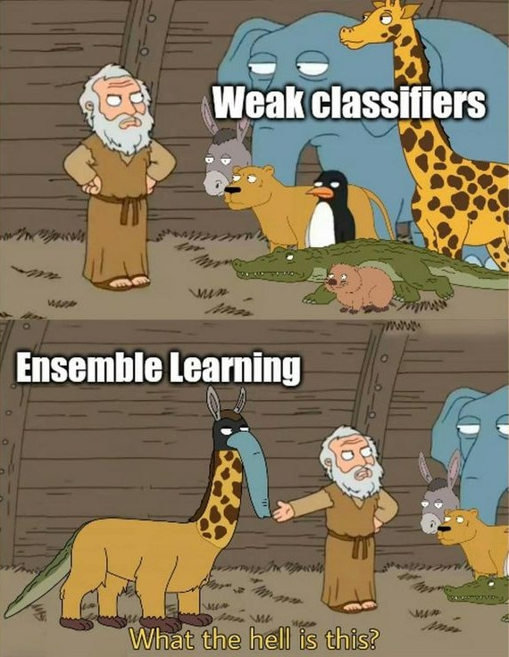
Boosting is an ensemble learning method From weak learners to strong learners Weak learner?
What is Boosting?
A decision tree!
Weak learner is a model that performs slightly better than random guessing
Notes:
Boosting is an ensemble learning method that combines a group of weak learners and turns them into strong learners to minimize training errors.
Starting with the bunch of weak learners, modifying during training and make them better learners and reduce the model error as much as possible.
In boosting, a random sample of data is selected, fit with a model and then trained sequentially — each model tries to compensate for the weaknesses/errors of the previous ones. Ensemble method is to train multiple models one after the other.
What is a weak learner? A decision tree with only a few splits; accuracy is slightly better than a 50%, random guessing. A shallow tree unlike a deep random forest tree for example.
To summarize boosting: Each new tree is built to improve the deficiencies of the previous trees and this concept is called boosting. See the boosting algorithm visually in the next slide.

Slide 4
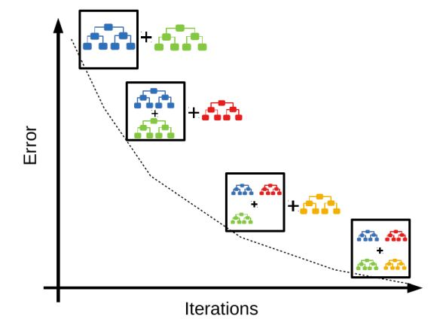
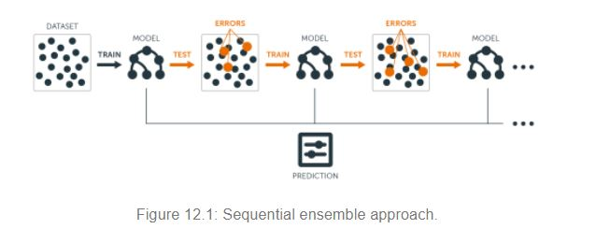
Sequential ensemble approach
Gradient Boosting Algorithm
Source
Notes:
Seq.Ens.appr. Is all about minimizing the errors.
First built a model, find its residual and build another model on the previous residual. Repeat this process as many times as required until the errors are at the min. point.
Without any math: Imagine, that you are trying to solve a very difficult problem. You give an initial solution, which may be bad, but then you see where you are wrong, and you are going to improve that solution by improving your mistakes. In every iteration you alternate your strategy to correct the mistakes you made in the previous one.

Slide 5
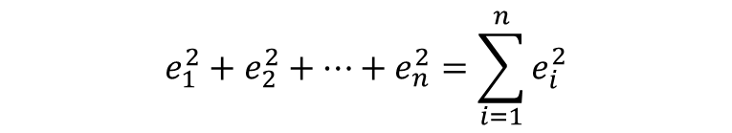
Three main components of Gradient Boosting
1
Loss function
$$e_{1}^{2}+e_{2}^{2}+…+e_{n}^{2}=\sum_{i=1}^{n}{e_{i}^{2}}$$
0
2
Weak learner
3
Additive model
Notes:
Gradient boosting involves three main steps. Gradient boosting adds sub-models incrementally to minimize a loss function.
We optimize a loss function as the algorithm builds each tree. What is loss, remember Linear reg uses OLS. The loss function depends on the type of problem. For example, regression may use a squared error and classiﬁcation may use logarithmic loss. The gradient part of gradient boosting comes from minimizing the errors. This is the gradient part of gradient boosting.
2. Each new tree is a weak learner. Weak learners can be controlled by some parameters, so they can remain weak, i.e., we need to constraint their splits.
3. The decision trees are built additively. Each decision tree is built one after another. Sequence is important.

Slide 6

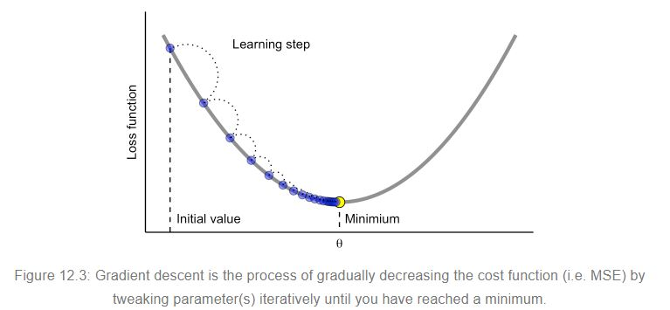
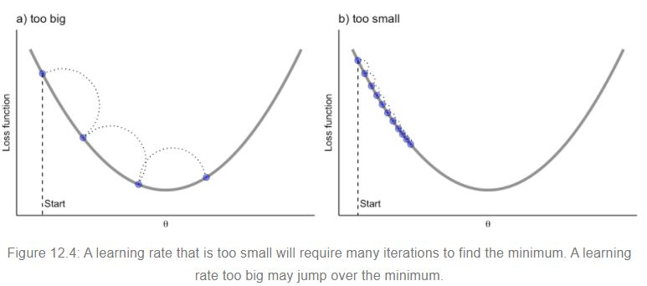

Loss function Three main components of Gradient Boosting
Gradient boosting algorithm
Gradient descent
minimizing an error function i.e., RMSE
Starting point: Base model error with the worst prediction
Step size!
Learning rate
Notes:
Zoom in loss function and introduce one parameter GBM uses, closely related with the loss function.
Gradient boosting algorithm uses the gradient descent to minimize an error function such as RMSE. Whenever gradient boosting algorithm adds a new tree, the gradient descent procedure moves towards to minimize the loss.
1. The gradient boosting algorithm builds each tree to minimize the errors, to optimize the loss function. The loss function depends on the type of problem, i.e., RMSE.
Gradient descent optimization in the GBM world is building meta-models consisting of multiple weak models that their output is added on top of each other to get a final optimized prediction.
LR: while minimizing the errors, we need to decide the speed of learning. It adjusts the size of incremental steps, meaning, penalizes the importance of each consecutive iteration.
Not all cost functions are convex like in the first graph

Slide 7
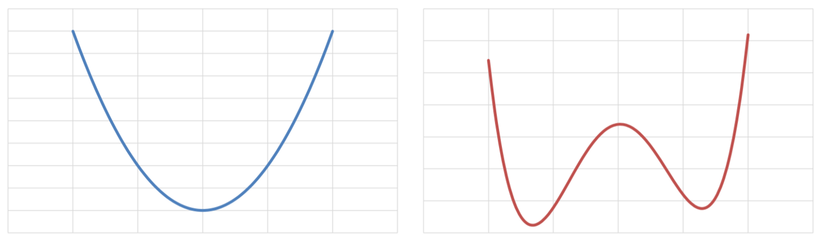
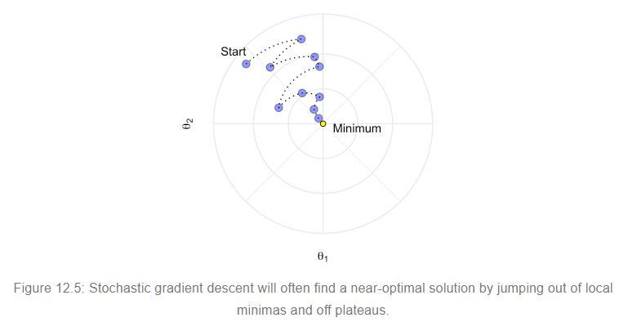
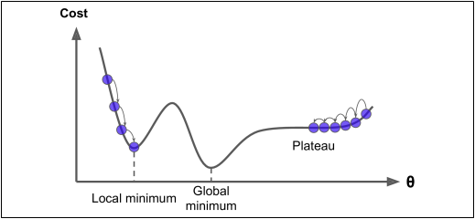
Stochastic gradient descent Loss function
Not all cost functions are convex!
Adding some randomness and speed in the gradient descent
Convex
Non-convex
Sampling a small number of training data points
+
Mini-batch gradient descent
Notes:
There may be local minimas, plateaus, and other irregular terrain of the loss function that makes finding the global minimum difficult. Stochastic gradient descent can help us address this problem by sampling a fraction of the training observations (typically without replacement) and growing the next tree using that subsample.
This makes the algorithm faster, but the stochastic nature of random sampling also adds some randomness in the loss function’s descending process. Although this randomness does not allow the algorithm to find the absolute global minimum, it can help the algorithm jump out of local minima and off plateaus to get sufficiently near the global minimum.

Slide 8

Math behind GBM
New prediction target
House sale price prediction
Four data points from Ames housing dataset
Sale price (in thousands $) | Overall quality | Gr liv area | Predicted sale price | Error | Predicted error
215 | 6 | 1656
167 | 6 | 1516
95 | 3 | 1699
220 | 7 | 1782
174
41
39
174
-7
-9
174
-79
-71
174
46
41
1. Worst prediction (base model 0):
$\frac{215+167+95+220}{4}$ = 174
New prediction on top of Model 0: 174 + (0.1 ✖ -79) = 166
New error: 95 – 166 = -71
2. Model 1 fits on Error
Overall qual < 5
y
n
Liv area < 1680
Model 0 + Model 1 + … + Model n = Final prediction
Liv area >= 1680
y
n
y
n
-79
46
41
-7
Notes:
Start from the worst prediction = avg. sale price. Base model, if you can call it a model actually, no model yet.
Error: how much the prediction deviated from the actual sale price. Observed price – avg. price. Ex/ prediction is 41000 USD off
2. Errors will be predicted
3. LR = at what speed you want to change the predicted value

Slide 9
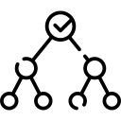

GBM | Applying GBM on Ames housing dataset to determine error on model 0
House sale price prediction
Four data points from Ames housing dataset
Calculations
New prediction target
1. Worst prediction (base model 0):
$\frac{215+167+95+220}{4}$ = 174
Sale price (in thousands $) | Overall quality | Gr liv area | Predicted sale price | Error
215 | 6 | 1656
167 | 6 | 1516
95 | 3 | 1699
220 | 7 | 1782
2. Model 1 fits on Error
174
41
174
-7
Overall qual < 5
174
-79
174
46
Liv area < 1680
Liv area >= 1680
-79
46
41
-7
Notes:
Start from the worst prediction = avg. sale price. Base model, if you can call it a model actually, no model yet.
Error: how much the prediction deviated from the actual sale price. Observed price – avg. price. Ex/ prediction is 41000 USD off
2. Errors will be predicted
3. LR = at what speed you want to change the predicted value

Slide 10

GBM | Applying GBM on Ames housing to show improvement in error in model 1
Sale price (in thousands $) | Overall quality | Gr liv area | Predicted sale price | Error | Predicted error
215 | 6 | 1656
167 | 6 | 1516
95 | 3 | 1699
220 | 7 | 1782
174
41
39
174
-7
-9
174
-79
-71
174
46
41
Model 0
Model 1
New prediction on top of Model 0: 174 + (0.1 ✖ -79) = 166
New error: 95 – 166 = -71
Model 0 + Model 1 + … + Model n = Final prediction

Slide 11
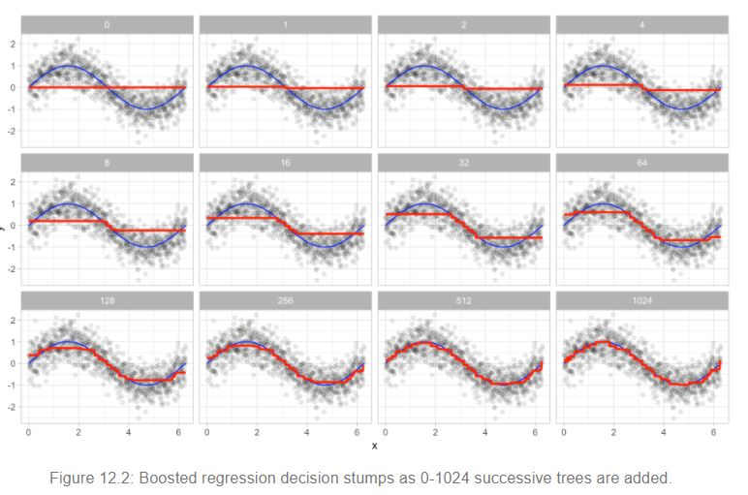
Model 0 + Model 1 + … + Model n = Final prediction
Blue line: one predictor (x)
From Model 0 to Model 1024, initial large
errors reduce.
Notes:
Each decision tree is fit to the previous one’s errors. Initially errors are large, but each additional tree makes a small improvement in errors, in various areas. Some irreducible error remain.

Slide 12
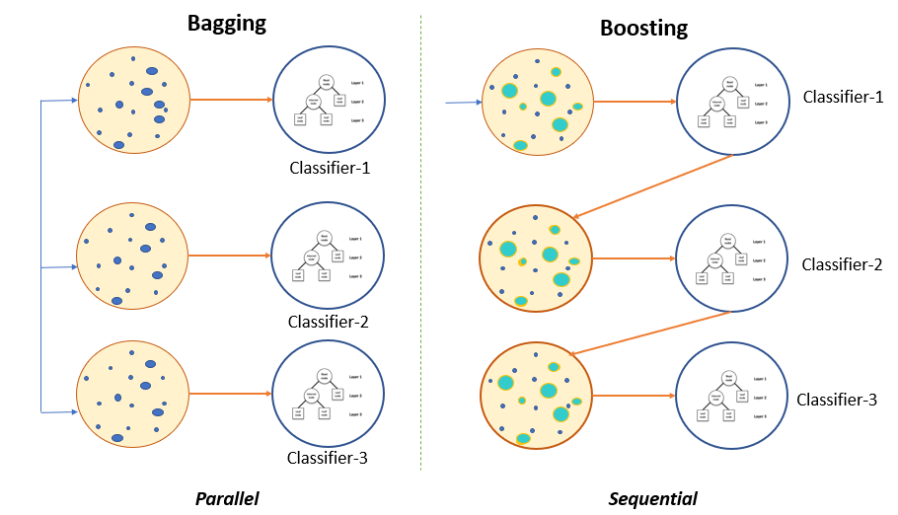
RF vs GBM
Ensemble technique
RF
GBM
Bagging “Train & keep”
Independent and simultaneous trees
Average of results at the end
Random training subsets
Each tree can fit subsample
Boosting “Train & Evaluate”
Sequential tree chain
Combine results along the way
Training subsets contain previously misclassified observations
A tree doesn’t fit into the entire dataset
Source
Notes:
An intermezzo
The main difference between these learning methods is the way in which they are trained.
The main point of GBM is that each tree is added one after the other to improve the overall model. This contrasts with random forests which build and calculate each decision tree independently by taking average at the end.
Bagging: majority. Millioner game.
Boosting: teamwork, project deadline, you wait input from your colleague or assignment team member so you can continue.
In the case of Bagging, any element has the same probability to appear in a new data set. However, for Boosting the observations are weighted and therefore some of them will take part in the new sets more often. Overfitting risk less.
GBM tends to be more powerful than RF in terms of accuracy but it also requires more computation time to grow the final model. However, Random Forests can handle extremely high dimensional input sets which makes them an excellent choice when dealing with a large number of variables (e.g., genomics data) whereas GBMs cannot effectively work with such high-dimensional data due to overfitting risk (especially when dealing with a large number of variables). However, parameter tuning can help avoid the issue.
If you carefully tune parameters, gradient boosting can result in better performance than random forests. However, gradient boosting may not be a good choice if you have a lot of noise, as it can result in overfitting.
Random forests and gradient boosting each excel in different areas. Random forests perform well for multi-class object detection and bioinformatics, which tends to have a lot of statistical noise. Gradient Boosting performs well when you have unbalanced data such as in real time risk assessment.

Slide 13


Hyperparameters
Hyperparameters
Number of trees
Learning rate
Tree depth
Minimum observations
n.trees
shrinkage
interaction.depth
n.minobsinnode
The optimized number of trees to minimize the loss function
Cross validation must be used to stop adding trees!
Contribution of each tree on the final outcome
Controls the speed of changing the prediction
0 – 1 range; smaller the value, more robust the model
The number of split on a tree
Checks the interections between predictors (if interaction.depth>1)
3 – 8 range; smaller the value, more tree, less interaction
The minimum number of observations in terminal/leaf nodes
The number of minimum observations depends on the dataset
Together they decide the tree numbers for optimal prediction
Notes:
Tuning parameters are quite important to avoid overfitting as GBM is prone to it. Managing the code running time as GBM can go on forever unless you say stop. Look at parameters’ dynamics with each other and impact on the result and code running time.
GBMs will chase residuals if you allow them to. So, we need to tell it to stop at some point. That’s why we use some params.
1. That’s why we need to enter a number of trees that it can use max. They can easily overfit we must find the optimal number of trees that minimize the loss function by using cross validation.
2. Controls how quickly the algorithm proceeds down the gradient descent. Values range from 0–1 with typical values between 0.001–0.3. Smaller values make the model robust to the specific characteristics of each individual tree, thus allowing it to generalize well. Smaller values also make it easier to stop prior to overfitting; however, they increase the risk of not reaching the optimum with a fixed number of trees and are more computationally demanding. Generally, the smaller this value, the more accurate the model can be but also will require more trees in the sequence.
3. The maximum depth of each tree( i.e. highest level of variable interactions allowed while training the model). Each split increases the total number of nodes by 3 (node → {left node (y), right node (n), NA node}). Higher depth trees allow the algorithm to capture unique interactions but also increase the risk of over-fitting. Larger the dataset, more tolerable to deeper trees. Generally, a larger depth needs to be combined with a smaller shrinkage rate.
4. Typical values range from 5–15 where higher values help prevent a model from learning relationships which might be highly specific to the particular sample selected for a tree (overfitting) but smaller values can help with imbalanced datasets. Ex/ collection targets: one customer has lots of txn data. We put min.obs 50 to avoid overfitting.
In general, a smaller shrinkage rate and a larger tree number are preferable.

Slide 14
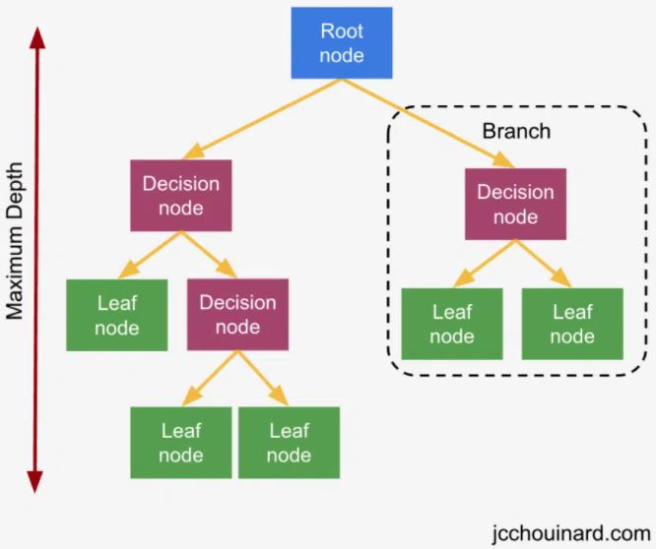
interaction.depth = 3
Maximum number of branches between
the top and the lower end

Slide 15
Implementation in R to show the prediction error improvement
Basic GBM Model
fit <- gbm(
formula = SalePrice ~ .,
data = train,
n.trees=1500,
interaction.depth=3,
distribution="gaussian",
n.minobsinnode=10,
shrinkage=0.05,
cv.folds = 10)
# Loss function obtained from the best number of iterations/trees
best.iter <- gbm.perf(fit) 853 trees
# Model evaluation: making prediction on the test set with the model derived from the train set
test$pred <- predict(fit, newdata = test[, -1], n.trees = best.iter)
testRMSEWorst <- rmse(mean(train$SalePrice), test$SalePrice)
# Prediction error
testRMSE <- rmse(test$pred, test$SalePrice)
Prediction error improved by
35%
Iteration 1
Average worst RMSE: 77.488
Iteration 853
Average RMSE: 27.422
Necessary R package
library(gbm)
Supporting R packages for data wrangling & model visualization
library(dplyr)
library(tidyverse)
library(ggplot2)

Slide 16
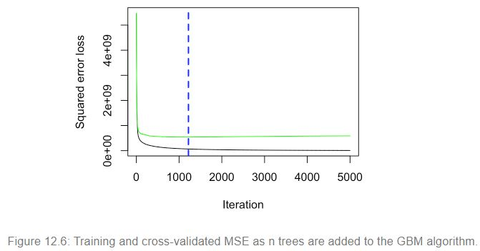

Optimum number of trees “cv” method Implementation
Plot error curve: gbm.perf(fit)
1219
Black line: error on training set
Green line: error on testing set/validation
Blue dotted line: optimal number of trees
What happens after the 1219th iteration?
Overfitting!
k-fold CV method “groupKFold()”
If one Order(Id) has multiple rows in the dataset, they will be in the same set.
Notes:
Overfitting (error on test data/unseen data increases, model learns/memorizes the training data and don’t do good on unseen data) vs. Underfitting
K-fold: nothing from the training dataset leaks to the test set.

Slide 17
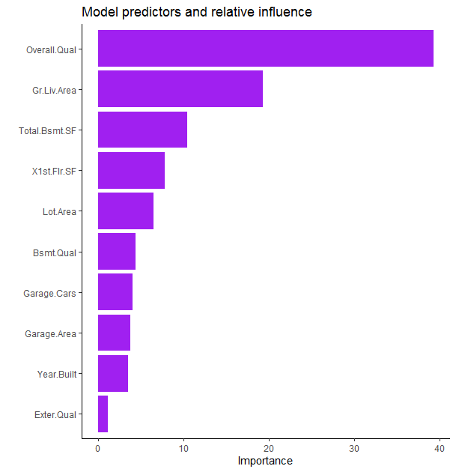
Variable importance Implementation
Top 10 most important variables according to the book “Hands-On Machine Learning with R ”
R package to plot the variable importance: library(vip)

Slide 18
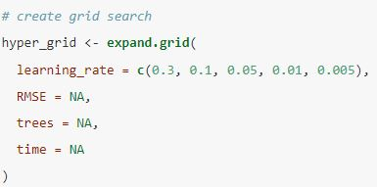
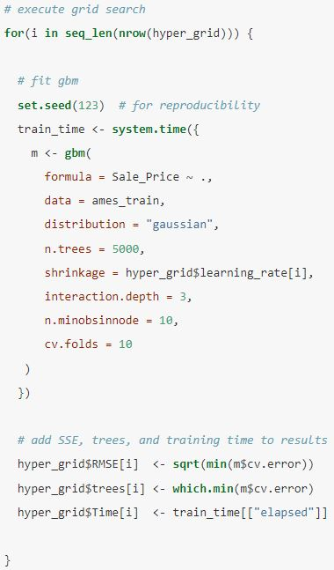
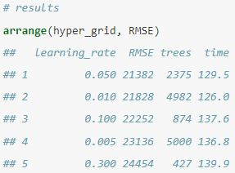
Learning Rate | How to determine the most suitable learning rate in R ?
Step 1. Create grid search
Step 2. Run GBM with various learning rates
Step 3. Output

Slide 19
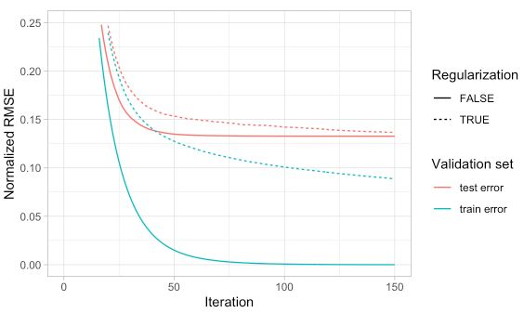
XGBoost
XGBoost advantages
Necessary R package
library(xgboost)
Speed
Performance
Parallel processing: The model is implemented to train with multiple CPU cores. Best possible split is determined faster.
Regularization: Extra protection against overfitting; it corrects more complex models by implementing both the LASSO and Ridge regularization.
Auto pruning: A tree can’t grow beyond a certain level.
Figure 12.7: When a GBM model significantly overfits to the training data (blue), adding regularization (dotted line)
causes the model to be more conservative on the training data, which can improve
the cross-validated test error (red).
Notes:
Boosted version of the gradient boosting algorithm. It is a specific implementation of the Gradient Boosting method which uses more accurate approximations to find the best tree model. Both xgboost and gbm follows the same principle of gradient boosting. There are some differences in modeling details.
It focuses on faster computation speed and better model performance. Better than basic GBM in two aspects: speed and perf.
Parallelization – It can harness all the processing power of the machine. Using a cluster of machines to train a model using distributed computing.
Regularization – Extra protection against overfitting by including different regularization penalties, less pred. variability, improved accuracy.
Prevent overfitting by including different regularization penalties, less pred. variability, improved accuracy.
Auto pruning: a biased variable will be taken care automatically, so robust model.
In XGBoost the size of the tree and the magnitude of the weights are controlled by standard regularization parameters.

Slide 20
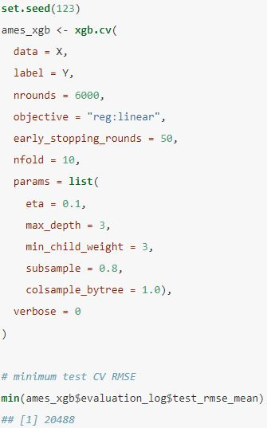
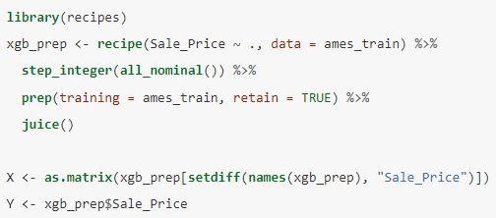
XGBoost implementation
Data preparation
Tune and run the model
Data: A matrix of the training data
Notes:
The general tuning strategy for exploring xgboost hyperparameters builds onto the basic GBM tuning strategies
data: a matrix of the training data
label: the response variable in numeric format (for binary classification 0 & 1)
objective: defines what learning task should be trained
nrounds: number of boosting iterations

Slide 21
The real-life application examples
Mainly areas non – linearity & interacting relationships between predictors exist
Credit lending
Healthcare
Cardiovascular risk factors
Cancer patient survival
Anomaly detection
DNA sequences
Credit card transactions (Fraud)
Cybersecurity
Image recognition
Search engines
Page ranking
Notes:
GBM performs well when you have unbalanced data such as risk assessment.
Credit lending: loan eligibility. Agents might not know if the applicant can pay back their loans. They might not see the pattern.
Healthcare: Ensembling models help to exploring complex interactions between risk factors. improve the accuracy in identifying patients who could benefit from preventive treatment of cardiovascular disease, while avoiding unnecessary treatment of others.
Fraud detection: For various reasons, fraud detection is considered a challenge for GBM because, for example, the distribution of data continually evolves over time due to new attack approaches and seasonality and because a very small percentage of all credit card transactions are fraudulent. Historical credit
card transactions are labeled as legitimate or fraudulent (supervised learning).
Dataset of credit card transactions to train the model to recognize fraud patterns faster than human agents. The model is self-learning which enables it to adapt to new, unknown fraud patterns. Adding data related to how the customers connect to the site: IP, device type etc. Where the model is not sure, then send customers to the human agents.
Anomaly detec: in supervised learning settings where data is often highly unbalanced (i.e. a few anomalies versus a huge amount of genuine/normal data)
Search engines for page rankings

Slide 22
Thank you
Notes:
Questions

